Slide 1
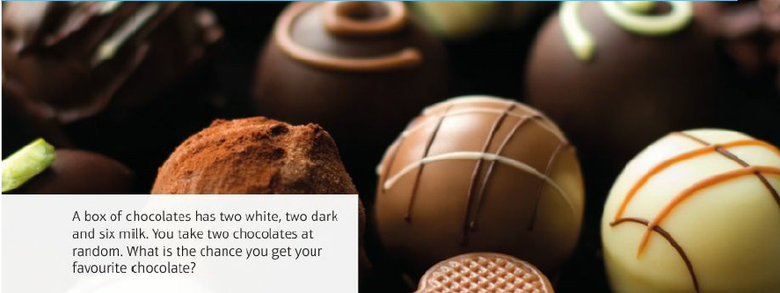
Mathematics (9-1) - iGCSE
2018-20
Year 09
A box of chocolates has two white, two dark and six milk. You take two chocolates at random. What is the chance that you get your favourite chocolate.
Unit 10 – Probability

Slide 2
Contents
Page iv
10 Probability 305
Prior knowledge check 305
10.1 Combined events 307
10.2 Mutually exclusive events 310
10.3 Experimental probability 312
10.4 Independent events and tree diagrams 314
10.5 Conditional probability 318
10.6 Venn diagrams and set notation 321
Problem-solving: Drug testing 325
Check up 326
Strengthen 328
Extend 333
Knowledge check 335
Unit test 336

Slide 3
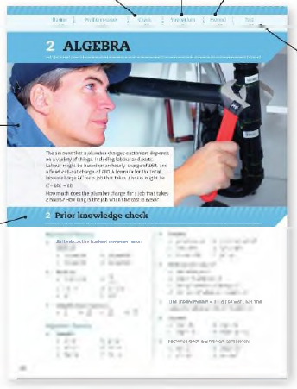
Contents
Page v
At the end of the Master lessons, take a check-up test to help you to decide whether to strengthen or Extend our learning
Extend helps you to apply the maths you know to some different situations
Unit Openers put the maths you are about to learn into a real-life context. Have a go at the question - it uses maths you have already learnt so you should be able to answer it at the start of the unit.
When you have finished the whole unit, a Unit test helps you see how much progress you are making.
Choose only the topics in strengthen thay you need a bit more practice with. You’ll find more hints here to lead you through specific questions. Then move on to Extend
Use the Prior knowledge check to make sure you are ready to start the main lessons in the unit. It checks your knowledge from Key Stage 3 and from earlier in the GCSE course. Your teacher has access to worksheets if you need to recap anything.

Slide 4
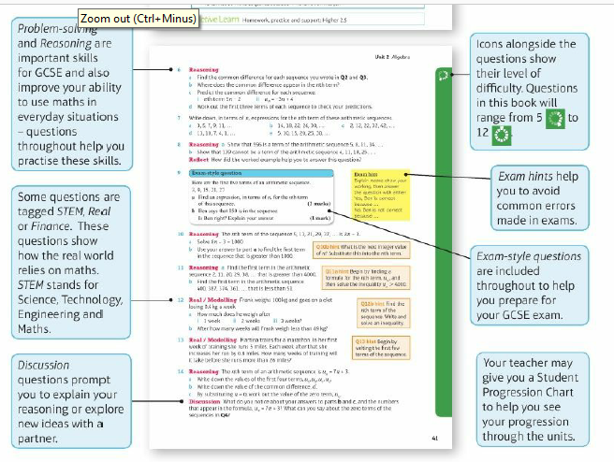
Contents
Page vi

Slide 5
10 – Prior Knowledge Check
Page 305
Numerical fluency
Work out
0.45 + 0.52 b. 0.6 + 0.25
0.52 - 0.17 d. 0.7 - 0.32
Work out
1 - 0.22 b. 1 - 0.76
1- $\frac{3}{5}$ d. 1 - $\frac{5}{12}$
100% - 27%
100% - 68%
Write three equivalent fractions for each fraction.
$\frac{1}{4}$ b. $\frac{2}{5}$ c. $\frac{5}{6}$ d. $\frac{7}{10}$

Slide 6
10 – Prior Knowledge Check
Page 305
Numerical fluency
Write these fractions in ascending order. $\frac{3}{8}$ $\frac{5}{12}$ $\frac{2}{7}$ $\frac{1}{3}$ $\frac{2}{5}$
Work out
0.25 x 160 b. 0.2 x 120
0.48 x 55 d. $\frac{1}{3}$ x 150
$\frac{5}{8}$ x 480 f. $\frac{7}{10}$ x 180
Convert these fractions to decimals and percentages
$\frac{1}{4}$ b. $\frac{3}{10}$ c. $\frac{3}{5}$
$\frac{3}{8}$ e. $\frac{17}{20}$ f. $\frac{37}{80}$

Slide 7
10 – Prior Knowledge Check
Page 305
Numerical fluency
Work out
20% of 340
35% of 234
82% of 250
7% of 60
Work out
$\frac{2}{3}$ + $\frac{1}{4}$ b. $\frac{3}{5}$ + $\frac{1}{6}$
$\frac{5}{6}$ - $\frac{1}{4}$ d. $\frac{7}{12}$ = $\frac{3}{7}$

Slide 8
10 – Prior Knowledge Check
Page 305
Fluency with probability
a. Copy the probability scale.
Write the capital letter of each event in the correct place on your scale.
Rolling an even number on a fair six-sided dice.
The probability of landing a 5 on a biased spinner is 30%.
The probability that two people will share their birthday from a class of 30 students is 0.7.
The probability of an 18-24-year- old having a car accident within two years of passing their driving test is $\frac{1}{4}$.
The probability of a 60-year-old male not surviving to his next birthday is 1%.

Slide 9
10 – Prior Knowledge Check
Page 305
Fluency with probability
The frequency table shows the outcomes in a study of a new weight-loss regime to tackle obesity,
Copy the table.
Work out the total frequency,
Calculate the relative frequencies,
A further 300 people sign up to the weight-loss regime. How many of them would you expect to fall into the 'healthy' category?
Outcome | Frequency | Relative Frequency
Healthy target | 78
‘Overweight’ category | 17
‘Obese’ category | 5
Total frequency

Slide 10
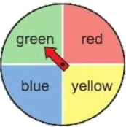
10 – Prior Knowledge Check
Page 305
Reasoning An ordinary six-sided dice is rolled once.
List all the possible outcomes,
What is the probability of each outcome?
What is the sum of all their probabilities?
Reasoning In a game, players spin the coloured spinner to move around the board.
What is the theoretical probability of landing on green if the spinner is fair?
How many times would you expect to land on each colour in 100 spins?
In a game there are 100 spins. Here are the results:
What is the experimental probability of getting yellow?
Colour | Red | Yellow | Blue | Green
Frequency | 25 | 28 | 24 | 23

Slide 11
10 – Prior Knowledge Check
Page 306
The table gives the numbers of boys and girls in a group who wear glasses
Copy and complete the table.
A person is picked at random. What is the probability the person is:
a boy without glasses
a girl?
 | Glasses | No Glasses | Total
Boys |  | 10
Girls | 6
Total |  |  | 32

Slide 12
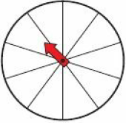
10 – Prior Knowledge Check
Page 306
A bag contains red, blue and yellow counters. The probability of choosing a red counter is 0.2 and the probability of choosing a blue counter is 0.35. Work out the probability of choosing a red or blue counter.
* Challenge
Use the numbers 1, 2 and 3 as many times as you like on the spinner to make these statements true.
P(odd number) > P(even number)
P(1) = 2P(3)
Find a different solution.

Slide 13
10.1 – Combined Events
Page 307
Objectives |  | Why Learn This?
Use the product rule for finding the number of outcomes for two or more events. List all the possible outcomes of two events in a sample space diagram. |  | The word probability comes from the Latin word 'probabilitas' which can have different meanings. In Europe it is a measure of the 'authority' of a witness in legal cases.
Fluency
List all the possible outcomes when rolling a 6-sided dice.
ActiveLearn - Homework, practice and support: Higher 10.1

Slide 14
10.1 – Combined Events
Page 307
Jess is buying a car. She has a choice of four colours, red, blue, silver and white, and a choice of two models, an estate and saloon.
How many possible combinations of colour and model are there?
How many combinations are there for 5 colours and 2 models?
How many combinations are there for 6 colours and 2 models?
How many combinations are there for 6 colours and 3 models?
How many combinations are there for m colours and n models?
Warm Up
Questions in this unit are targeted at the steps indicated

Slide 15
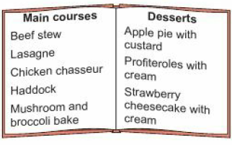
10.1 – Combined Events
Page 307
a. From a set menu of 5 main courses and 3 desserts, write all the combinations of main courses and desserts.
How many possible combinations are there?
What is the probability that the combination chosen from the menu is lasagne and profiteroles?
What is the probability that the combination chosen is haddock and a dessert served with cream?
Q2c hint - Lasagne and profiteroles are 1 combination out of a total of ◻ combinations so:
P (lasagne and profiteroles) = $\frac{1}{\text{◻}}$

Slide 16
10.1 – Combined Events
Page 307
Highfield Technology School has two students from each year group on the school council. Amy, Beth, Callum, Dan and Ellie would like to represent Year 11.
How many combinations of two students are there?
What is the probability that Amy will represent Year 11?
What is the probability that Ellie will represent Year 11?
What is the probability that Callum and Dan will represent Year 11?
Modelling Two fair coins are flipped at the same time,
Write a list of all the possible outcomes,
How many outcomes are there altogether?
Work out
P(two tails) ii. P(head and tail).
Q4c communication hint - P(two tails) means the probability of getting two tails.

Slide 17
10.1 – Combined Events
Page 308
Key Point 1
A sample space diagram shows all the possible outcomes of two events.
Example 1
Two fair five-sided spinners are spun and the results are added together.
Draw the sample space diagram to show all the possible outcomes.
Work out the probability of getting a total of 2.
Work out the probability of getting a total of 6.
Work out the probability of getting a total that is a prime number.
P(2) = $\frac{1}{25}$
P(6) = $\frac{5}{25}$ = $\frac{1}{5}$
P(prime) = $\frac{11}{25}$
 |  | Red Spinner
 |  | 1 | 2 | 3 | 4 | 5
Blue Spinner | 1 | ② | 3 | 4 | 5 | 6
 | 2 | 3 | 4 | 5 | 6 | 7
 | 3 | 4 | 5 | 6 | 7 | 8
 | 4 | 5 | 6 | 7 | 8 | 9
 | 5 | 6 | 7 | 8 | 9 | 10
Add the number on the red spinner to the number on the blue spinner.
$\frac{number of ways of scoring}{total number of scores}$
The outcomes that are prime numbers are 2,3,5 and 7.

Slide 18
10.1 – Combined Events
Page 308
Modelling Jake rolls a fair six-sided dice and spins a fair four-sided spinner and adds the results together.
Copy and complete the sample space diagram to show all the possible outcomes,
Work out the probability of getting
a total of 4
a total that is a square number
a total of 12.
 |  | Dice
 |  | 1 | 2 | 3 | 4 | 5 | 6
Spinner | 1 | 2 | 3
 | 2 | 3
 | 3
 | 4

Slide 19
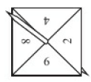
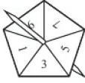
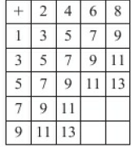
10.1 – Combined Events
Page 309
6 – Exam-Style Questions
Louise spins a four-sided spinner and a five sided spinner. The four-sided spinner is labelled: 2, 4, 6, 8.
The five-sided spinner is labelled: 1, 3, 5, 7, 9.
Louise adds the score on the four-sided spinner to the score on the five-sided spinner.
She records the possible scores in a table.
Complete the table of possible scores. (1 mark)
Write down all the ways in which Louise can get a total score of 11 One way has been done for you. (2,9) (2 marks)
Both spinners are fair.
Find the probability that Louise’s total score is less than 6 (2 marks)
Nov 2010, Q3, I380/3HJ
4 sided spinner
5 sided spinner
Q6 strategy hint - Use your completed table to answer parts b and c.

Slide 20
10.1 – Combined Events
Page 309
Modelling
Sasha rolls two fair six-sided dice. Draw a sample space diagram to show all of the possible outcomes,
How many possible outcomes are there altogether?
Work out the probability of getting a total of
3
an even number
greater than 8.
Which total are you most likely to get when rolling two six-sided dice?
Harry flips a fair coin three times. Work out the probability that the coin lands heads up for all three flips.
Q9 hint - List all possible outcomes.

Slide 21
10.1 – Combined Events
Page 309
Chloe has two bags of sweets, A and B. In bag A she has a strawberry flavour, an orange flavour, a lime flavour and a blackcurrant flavour sweet. In bag B she has a strawberry flavour, a blackcurrant flavour and a lime flavour sweet. Chloe takes a sweet at random from each bag.
Draw a sample space diagram to show all the possible outcomes,
Work out the probability that the sweets will be
both strawberry flavour
the same flavour
different flavours.

Slide 22
10.1 – Combined Events
Page 309
Jade, Kyle, Laura, Max and Nicole take part in a chess tournament. Each player in the tournament plays every other player. There are 10 matches altogether. Two players are picked at random to play the first game. Work out the probability that the first game will be played by a male player and a female player.

Slide 23
10.2 – Mutually Exclusive Events
Page 310
Objectives |  | Did You Know?
Identify mutually exclusive outcomes and events. Find the probabilities of mutually exclusive outcomes and events. Find the probability of an event not happening. |  | The oldest known dice ever excavated is 5000 years old. Dice used to be called 'bones' because they were made from a bone in the ankle of hoofed animals.
Fluency
Work out a. 0.53 + 0.2 b. 0.4 + 0.35 c. 1 - 0.72 d. 1 - 0.65 e. 1- $\frac{2}{5}$ f. 1 - $\frac{5}{9}$
ActiveLearn - Homework, practice and support: Higher 10.2

Slide 24
10.2 – Mutually Exclusive Events
Page 310
Boys and girls in a class are in the ratio of 1:2. What fraction of the class are boys?
A fair 6-sided dice is rolled once. What is the probability of rolling
a square number
a multiple of 2
a multiple of 3?
Here are some lettered tiles. One of these tiles is selected at random. Work out the probability of getting an E or an S.
Warm Up
I
S
O
S
C
E
L
E
S

Slide 25
10.2 – Mutually Exclusive Events
Page 310
Key Point 4
Two events are mutually exclusive if they cannot happen at the same time. For example, when you roll an ordinary dice, you cannot get a 3 and an even number at the same time.
Which two events from Q2 are mutually exclusive?
A fair 6-sided dice is rolled once. Workout the probability of rolling
a square number or a multiple of 5
a prime number or an even number
a square number or a multiple of 2.

Slide 26
10.2 – Mutually Exclusive Events
Page 310
Key Point 5
When events are mutually exclusive you can add their probabilities. For mutually exclusive events P(A or B) = P(A) + P(B)
Modelling A standard pack of cards is shuffled and a card is chosen at random. Find the probability of choosing
a diamond or spade
a black ace or a heart.
Q6 hint – A standard pack of 52 cards is equally split into four suits; hearts, diamonds, clubs and spades. For each suit there is an Ace, 2,3,4, 5,6, 7,8,9,10, Jack, Queen and King.

Slide 27
10.2 – Mutually Exclusive Events
Page 310
The chance of it raining on a day in July in London is 71%. There is a 6% chance of a dry day with cloud coverage. What is the probability that on a visit to London in July, you will have a clear blue sunny sky with no rain?
The numbered cards are shuffled. A card is chosen at random. Work out the probability of choosing a square number, a prime number or a multiple of 6.
Q7 hint – The sum of the probabilities of all possible outcomes is ◻%.
1
2
3
4
5
6
7
8
9
10

Slide 28
10.2 – Mutually Exclusive Events
Page 311
Key Point 5
For 3 or more mutually exclusive events, P(A or B or C or...) = P(A) + P(B) + P(C) + ... The probabilities of an exhaustive set of mutually exclusive events sum to 1.
Problem-solving The table gives the probability of getting each of 1,2,3 and 4 on a biased 4-sided spinner. Work out the probability of getting
a 2 or 4 b. 1 or 2 or 3.
Number | 1 | 2 | 3 | 4
Probability | 4x | 3x | 2x | x

Slide 29
10.2 – Mutually Exclusive Events
Page 311
Key Point 1
For mutually exclusive events A and not A, P(not A) - 1 – P(A). A and not A are always exclusive.
Example 2
A bag contains 20 counters. 7 of the counters are red. A counter is taken at random from the bag. Work out the probability that the counter will be
red b. not red.
a. P(red) = $\frac{7}{20}$
b. P(not red) = 1 – P(red)
= 1 - $\frac{7}{20}$
= $\frac{13}{20}$
P(A) = $\frac{number of successful outcomes}{total number possible outcomes}$
P(not A) = 1 – P(A)

Slide 30
10.2 – Mutually Exclusive Events
Page 311
Modelling A fair 6-sided d ice is rolled. Work out the probability of rolling
1 b. not 1.
Modelling A standard pack of cards is shuffled and a card is chosen at random. Find the probability of choosing a
heart b. not a heart.
The probability that it will rain tomorrow is 0.88. Work out the probability that it will not rain tomorrow.

Slide 31
10.2 – Mutually Exclusive Events
Page 311
13 – Exam-Style Questions
Josie rolls a biased dice.
The probability that the dice will land on 1 or 2 or 3 or 4 or 5 is given in the table.
Work out the probability that the dice will land on 6. (2 marks)
Nov 2011, Q2, 23S1/6B
Core | 1 | 2 | 3 | 4 | 5 | 6
Probability | 0.15 | 0.25 | 0.20 | 0.10 | 0.15

Slide 32
10.2 – Mutually Exclusive Events
Page 312
Reasoning Anna has a box of chocolates. In the box there are milk, plain and white chocolates in the ratio 4:3:2. Anna doesn't like white chocolates. Work out the probability that she will pick a chocolate that is not white.
Q14 hint - How many parts are there in total for the ratio4:3:2?
P(not white) = 1 - $\frac{◻}{◻}$

Slide 33
10.2 – Mutually Exclusive Events
Page 312
A and B are two mutually exclusive events. P(A) = 0.25 and P(A or B) = 0.6 Work out the value of P(B).
Problem-solving C and D are two mutually exclusive events. P(D) = 0.4 and P(C or D) = 0.78 Work out P(not C).
Q15 hint - For two mutually exclusive events, P(A or B) = P(A) + P(B)

Slide 34
10.3 – Experimental Probability
Page 312
Objectives |  | Did You Know?
Work out the expected results for experimental and theoretical probabilities. • Compare real results with theoretical expected values to decide if a game is fair. |  | Scientists use results from their experiments to work out the chance of a drug or treatment being successful.
Fluency
Simplify a. $\frac{9}{12}$ b. $\frac{15}{45}$ c. $\frac{24}{36}$ d. $\frac{27}{45}$
ActiveLearn - Homework, practice and support: Higher 10.3

Slide 35
10.3 – Experimental Probability
Page 312
Work out
50 x 0.3 b. 200 x 0.7
210 x $\frac{1}{3}$ d. 150 x $\frac{4}{5}$
Write the correct sign, < or >, between each pair of fractions.
$\frac{4}{7}$ and $\frac{2}{5}$ b. $\frac{5}{9}$ and $\frac{7}{11}$
$\frac{3}{10}$and $\frac{4}{15}$ d. $\frac{5}{12}$and $\frac{3}{8}$
Warm Up

Slide 36
10.3 – Experimental Probability
Page 312
Ella dropped a drawing pin on the table lots of times. It landed either point up or point down. She recorded her results in a frequency table.
Work out the total frequency.
Work out the experimental probability of the drawing pin landing
point up ii. point down.
She drops the drawing pin 100 times. How many times do you expect it to land point up?
Discussion When you repeat an experiment, will you get exactly the same results? Why is experimental probability only an estimate? How can you improve the accuracy of the estimate?
Position | Frequency
Point up | 43
Point down | 7

Slide 37
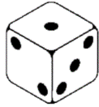
10.3 – Experimental Probability
Page 312
Key Point 7
In a probability experiment a trial is repeated many times and the outcomes recorded. The relative frequency of an outcome is called the experimental probability.
Experimental probability of an outcome = $\frac{\text{(}\text{frequency} \text{of} \text{outcome}\text{)}}{\text{(}\text{total} \text{number} \text{of} \text{trials}}$
4 – Exam-Style Questions
Abraham and Betty have a biased dice.
They each want to find an estimate for the probability that the dice will land on a six. Abraham is going to roll the dice 60 times. He will record the number of sixes he gets. Betty is going to roll the dice 600 times. She will record the number of sixes she gets. Who is more likely to get the better estimate?
Give a reason for your answer. (1 mark) March 2012, Q4, 2381/6B
Exam hint
You only get the mark for the name and a reason. Just writing the correct name scores 0 marks.

Slide 38
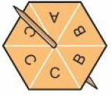
10.3 – Experimental Probability
Page 313
Key Point 8
Theoretical probability is calculated without doing an experiment.
Example 2
Josh uses this spinner for a game.
What is the theoretical probability that the spinner will land on the letter B?
Josh is going to spin this spinner 300 times,
Estimate how many times the spinner will land on the letter B.
a. P(B) = $\frac{2}{6}$ = $\frac{1}{3}$
b. $\frac{1}{3}$ x 300
= 100
Simplify fractions where possible.
Expected number of outcomes = number of trials x probability

Slide 39
10.3 – Experimental Probability
Page 313
Modelling Mia makes this 8-sided spinner for an experiment.
What is the theoretical probability that the spinner will land on blue? Mia is going to spin this spinner 400 times,
Estimate how many times the spinner will land on blue.
The probability of England losing their next football match is 0.28 The probability of England drawing their next football match is 0.36 Work out an estimate for the number of times England will win over their next 50 football matches.

Slide 40
10.3 – Experimental Probability
Page 313
Modelling There are red, blue and yellow counters in a bag in the ratio of 5:6:1.
What is the probability of choosing a red counter?
A counter is picked at random from the bag and then replaced. This is done 180 times.
How many times would you expect a red counter to be picked?
Key Point 9
As the number of experiments increases, the experimental probability gets closer and closer to the theorectical probability.

Slide 41
10.3 – Experimental Probability
Page 314
Modelling The table shows the results of rolling a six-sided dice,
Copy and complete the table, calculating the relative frequency for each outcome,
What is the experimental probability of rolling a 6?
When the dice is rolled 500 times, how many times would you expect to get a 6?
Is the dice fair? Give a reason for your answer.
Number | Frequency | Relative Frequency
1 | 23
2 | 22
3 | 21
4 | 18
5 | 9
6 | 7

Slide 42
10.3 – Experimental Probability
Page 314
Modelling The table shows the results of spinning a five-sided spinner. Is the spinner fair? Give a reason for your answer.
Modelling Holly flips two coins and records the result. She does this 160 times. One possible outcome is (tail, tail). Estimate the number of times she will get two tails.
Number | 1 | 2 | 3 | 4 | 5
Frequency | 46 | 39 | 37 | 40 | 38

Slide 43
10.3 – Experimental Probability
Page 314
Modelling The probability of winning a prize in a raffle is 535. Sarah says that if she buys 200 tickets she will win a prize. Is she right? Give a reason for your answer.
Modelling Ben rolls two dice 180 times. How many times would you expect to get a total
of 12 b. of 7
that is a prime number?
Modelling A dentist estimates that the probability a patient will come to see him needing a filling is 0.235. Of the next 160 patients who come to see him, 25 need a filling. How good is the dentist's estimate of this probability? Explain your answer.

Slide 44
10.4 – Independent Events and Tree Diagrams
Page 314
Objectives |  | Did You Know?
Draw and use frequency trees. Calculate probabilities of repeated events. Draw and use probability tree diagrams. |  | When you use a probability tree diagram to find the probability of two or more events you will avoid missing any combinations.
Fluency
Work out: a. $\frac{2}{5}$ + $\frac{1}{5}$ b. $\frac{4}{9}$ + $\frac{3}{9}$ c. $\frac{1}{2}$ + $\frac{1}{4}$ d. $\frac{3}{8}$ + $\frac{1}{4}$
ActiveLearn - Homework, practice and support: Higher 10.4

Slide 45
10.4 – Independent Events and Tree Diagrams
Page 314
Work out these calculations; give your answers in their simplest form.
$\frac{7}{10}$ x $\frac{2}{9}$ b. $\frac{5}{9}$ x $\frac{3}{4}$
$\frac{5}{7}$ x $\frac{13}{20}$ d. 0.4 x 0.2
0.6 x 0.7 f. 0.55 x 0.8
Warm Up
Key Point 10
A frequency tree shows two or more events and the number of times they occurred

Slide 46
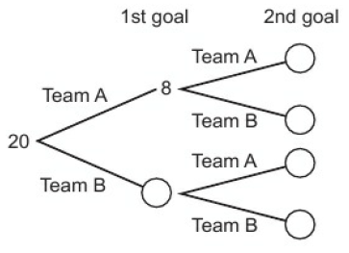
10.4 – Independent Events and Tree Diagrams
Page 315
In a football tournament 20 matches were played. In 8 of the matches Team A scored the first goal. In 5 of these matches they also scored the second goal. Team B scored the first two goals in 3 of the matches. Copy and complete the frequency tree for the 20 matches played.

Slide 47
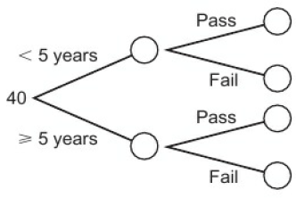
10.4 – Independent Events and Tree Diagrams
Page 315
A garage records the MOT test results on 40 cars. Of the 40 cars tested, 15 of them are less than 5 years old. 11 of the cars under 5 years old passed. 28 cars passed altogether,
Copy and complete the frequency tree,
Work out the probability that a car fails its MOT.

Slide 48
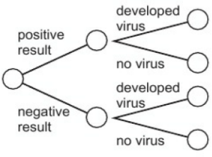
10.4 – Independent Events and Tree Diagrams
Page 315
STEM 80 people with similar symptoms were tested for a virus using a new trial medical test. 19 of the people tested showed a positive result. The virus only developed in 11 of the people who tested positive. A total of 67 people did not develop the virus at all.
Copy and complete the frequency tree,
Work out the probability that a person develops the virus.

Slide 49
10.4 – Independent Events and Tree Diagrams
Page 315
Key Point 11
Two events are independent if one event does not affect the probability of the other.
For example, flipping heads with a coin has no effect on rolling an even number with a dice, so they are independent events.
To find the probability of two independent events, multiply their probabilities.
P(A and B) = P(A) x P(B)
Connor and Ryan compete against each other over a 100 metre sprint and over a 100 metre swim. The probability that Connor will win the sprint is 0.3 The probability that Connor will win the swimming is 0.8 Assuming that the two events are independent, work out the probability that Connor will win both races.

Slide 50
10.4 – Independent Events and Tree Diagrams
Page 316
Reasoning There are two sets of traffic lights on Matthew's car journey to school. The probability that he has to stop at the first set of traffic lights is 0.45. The probability that he has to stop at the second set of traffic lights is 0.35. Work out the probability that he will
not stop at the first set of traffic lights
not stop at the second set of traffic lights
not stop at either set of traffic lights.
Discussion What assumption did you make?
Joe plays a spin-the-wheel game at the fair. The probability that he wins is $\frac{3}{5}$. Calculate the probability that he wins three successive games.

Slide 51
10.4 – Independent Events and Tree Diagrams
Page 316
A card is taken at random from each of two ordinary packs of cards, pack A and pack B. Work out the probability of getting
a black card from pack A and a black card from pack B
a heart from pack A and a spade from pack B
a queen from pack A and an even-numbered card from pack B
an ace from pack A and an ace of clubs from pack B
a queen of hearts from each pack.
Key Point 12
A tree diagram shows two or more events and their probabilities

Slide 52
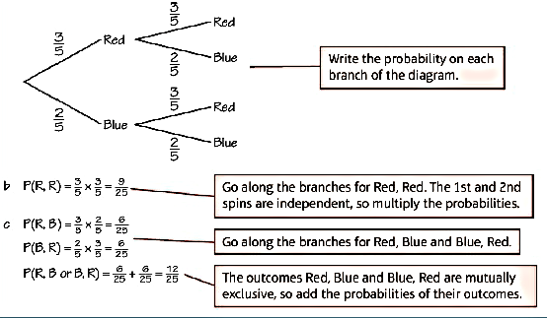
10.4 – Independent Events and Tree Diagrams
Page 316
Example 4
This fair five-sided spinner is spun twice,
Draw a tree diagram to show the probabilities,
What is the probability of both spins landing on red?
What is the probability of landing on one red and one blue?.
a.

Slide 53
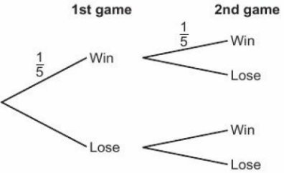
10.4 – Independent Events and Tree Diagrams
Page 317
On a hook-a-duck game at a fundraising event you win a prize if you pick a duck with an 'X' on its base. Aaron picks a duck at random, replaces it and then picks another one.
Copy and complete the tree diagram to show the probabilities,
What is the probability of
winning two prizes
winning nothing
winning one prize
winning at least one prize?
X
x
Q9b hint – Winning 'at least one’ means winning one or more.

Slide 54
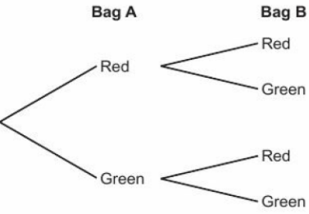
10.4 – Independent Events and Tree Diagrams
Page 317
Megan has two bags of counters, labelled A and In bag A there are 3 red and 5 green counters. In bag B there are 1 red and 5 green counters. A counter is chosen at random from each bag.
Copy and complete the tree diagram to show the probabilities,
Work out the probability of choosing
two counters the same colour
one red and one green counter
no red counters
at least one red counter.
Discussion How did you calculate P(at least one red)? Is there another way?

Slide 55
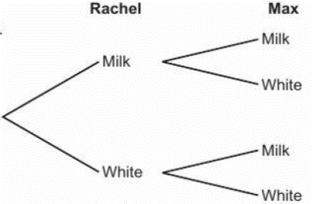
10.4 – Independent Events and Tree Diagrams
Page 317
Rachel and Max each have a box of chocolates. Rachel has 5 milk and 2 white chocolates in her box. Max has 7 milk and 3 white chocolates in his box. They each choose a chocolate from their own box at random.
a Copy and complete the tree diagram to show the probabilities,
Work out the probability that
they both choose a milk chocolate
one of them chooses a milk chocolate and one of them chooses a white chocolate.
Discussion What assumptions have you made when calculating the probabilities in part b?

Slide 56
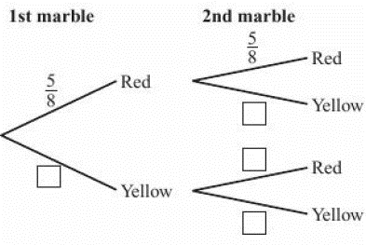
10.4 – Independent Events and Tree Diagrams
Page 317
12 – Exam-Style Questions
There are only red and yellow marbles in a bag. There are 5 red marbles and 3 yellow marbles. Ethan takes at random a marble from the bag, notes the colour and then puts the marble back in the bag.
Ethan then repeats this process,
Complete the probability tree diagram. (2 marks)
Work out the probability that Ethan takes marbles of different colours. (3 marks)

Slide 57
10.4 – Independent Events and Tree Diagrams
Page 318
Reasoning Caitlin spins two spinners. On spinner 1, P(pink) = 0.2 On spinner 2, P(pink) = 0.35
Draw a tree diagram to show all the possible outcomes.
What is the probability of only one spinner landing on pink?
What it is the probability of both spinners landing on pink?
If each spinner was spun 500 times, how many times would you expect them both to land on pink?

Slide 58
10.5 – Conditional Probability
Page 314
Objectives |  | Why Learn This?
Decide if two events are independent. Draw and use tree diagrams to calculate conditional probability. Draw and use tree diagrams without replacement. Use two-way tables to calculate conditional probability. |  | Conditional probability is used in most type of statistics.
Fluency
There are 4 red counters in a bag of 10 counters. What is a. P(red) b. P(not red)?
ActiveLearn - Homework, practice and support: Higher 10.5

Slide 59
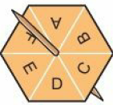
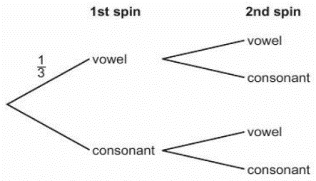
10.5 – Conditional Probability
Page 318
This spinner is spun twice.
Copy and complete the tree diagram to show all the probabilities,
Work out the probability of the spinner landing on a vowel for both spins.
Warm Up

Slide 60
10.5 – Conditional Probability
Page 318
The two-way table shows the subjects students like best. Work out the probability that a student picked at random
likes English best
does not like science best.
Work out the probability that a male student picked at random likes maths best.
Warm Up
 | English | Maths | Science | Total
Male | 15 | 23 | 22 | 60
Female | 32 | 17 | 21 | 70
Total | 47 | 40 | 43 | 130

Slide 61
10.5 – Conditional Probability
Page 318
Key Point 13
If one event depends upon the outcome of another event, the two events are dependent events. For example, removing a red card from a pack of playing cards reduces the chance of choosing another red card.
A tree diagram can be used to solve problems involving dependent events.
For each of the events, state if the events are independent or dependent.
Randomly choosing a chocolate from a box, eating it, and then choosing another,
Rolling two six-sided dice,
Flipping a coin three times,
Choosing two socks from a drawer.
Randomly choosing a counter from a bag, replacing it and then choosing another counter.
Key Point 14
A conditional probability is the probability of a dependent event. The probability of the second outcome depends on what has already happened in the first outcome.

Slide 62
10.5 – Conditional Probability
Page 319
Real The two-way table shows the number of deaths and serious injuries caused by road traffic accidents in Great Britain in 2013. Work out an estimate for the probability
that the accident is fatal given that the speed limit is 30mph
that the accident happens at 20 mph given that the accident is serious
that the accident is serious given that the speed limit is 40 mph. Give your answers to 2 decimal places.
 |  | Speed Limit
 |  | 20 mph | 30 mph | 40 mph | Total
Type of Injury | Fatal | 6 | 520 | 155 | 681
 | Serious | 420 | 11582 | 1662 | 13664
 | Total | 426 | 12102 | 1817 | 14345
Q4a hint - $\frac{number of fatal accidents at 30 mph}{total number of accidents at 30 mph}$

Slide 63
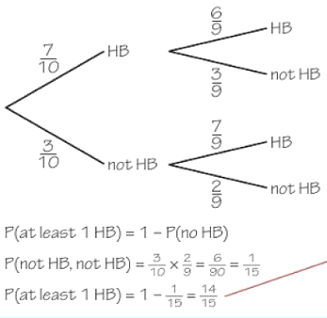
10.5 – Conditional Probability
Page 319
Example 5
There are 10 pencils in Toby's pencil case. Seven of the pencils are HB pencils. Toby takes two pencils out of his pencil case.
Draw a tree diagram to show all the possible outcomes.
Work out the probability that he picks out at least one HB pencil.
1st pencil 2nd pencil
a.
Taking two pencils from the pencil case at the same time is the same as taking one pencil, then another (without replacement).
You don't need to simplify probability fractions, but sometimes it makes calculations easier.

Slide 64
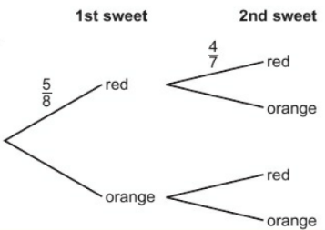
10.5 – Conditional Probability
Page 320
Chris has a bag containing 5 red and 3 orange sweets. He chooses a sweet at random and eats it. He then chooses another sweet at random.
Copy and complete the tree diagram to show all the probabilities,
Work out the probability that the sweets will be
the same colour
one of each colour iii. not orange.

Slide 65
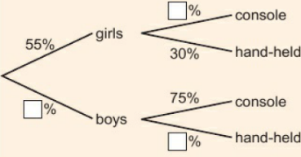
10.5 – Conditional Probability
Page 320
Problem-solving In a group of students, 55% are girls. 30% of these girls prefer to play electronic games on a hand-held gaming device. 75% of the boys prefer to play electronic games on a games console. One student is chosen at random. Find the probability that this is a boy who prefers to play games on a hand-held gaming device.
Q6 hint – Draw a tree diagram

Slide 66
10.5 – Conditional Probability
Page 320
Problem-solving Callum either walks to school or travels by car. The probability that he walks to school is 0.65. If he walks to school, the probability that he will be late is 0.3 If he travels to school by car, the probability that he will be late is 0.05 Work out the probability that he will not be late.
Problem-solving There are 5 boxes of cornflakes and 7 boxes of puffed wheat. Mike and Reece both choose a box at random. Work out the probability that they do not choose the same type.

Slide 67
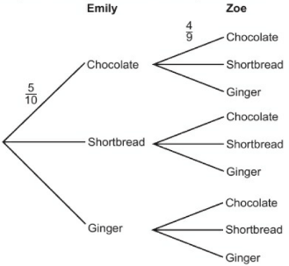
10.5 – Conditional Probability
Page 320
Emily and Zoe have 5 chocolate biscuits, 3 shortbread biscuits and 2 ginger biscuits in a tub. Emily picks a biscuit, at random, from the tub. Then Zoe picks a biscuit,
Copy and complete the diagram to show all the probabilities.
What is the possibility that they both pick the same type of biscuit?

Slide 68
10.5 – Conditional Probability
Page 321
Problem-solving A bag contains 4 red, 3 blue and 2 green marbles. Jamie chooses two counters, at random, from the bag. Work out the probability that his two counters are the same colour.
11 – Exam-Style Questions
There are 3 orange sweets, 2 red sweets and 5 yellow sweets in a bag. Sarah takes a sweet at random.
She eats the sweet.
She then takes another sweet at random.
Work out the probability that both
sweets are the same colour. (4 marks)
June 2010, Q26, 1380/3H
Q11 strategy hint - Once a sweet has been taken, and eaten, remember the total number of sweets in the bag is now one less.

Slide 69
10.6 – Venn Diagrams and Set Notation
Page 321
Objectives |  | Why Learn This?
Use Venn diagrams to calculate conditional probability. Use set notation. |  | John Venn, born in Kingston upon Hull, first introduced Venn diagrams in 1880.
Fluency
What are the integer values in each set? (x: 0< x ≤ 5) b. (x: -3 ≤ x < 2)
ActiveLearn - Homework, practice and support: Higher 10.6

Slide 70
10.6 – Venn Diagrams and Set Notation
Page 321
Amber surveyed Year 10 students to see how many owned a smartphone and tablet. The Venn diagram shows her results,
How many students did not own either a smartphone or tablet?
How many students owned a tablet?
How many students owned both a smartphone and a tablet?
How many students took part in Amber's survey?
Warm Up
Smartphone Tablet
17 15
2

Slide 71
10.6 – Venn Diagrams and Set Notation
Page 321
Key Point 15
Curly brackets {} show a set of values. ϵ means 'is an element of’.
A = {positive even numbers < 10} B = {prime numbers < 10}
List the numbers in each set. A = {2, ...} B = {...}
Write 'true' or 'false' for each statement.
6 ϵ A
1 ϵ B
5 ϵ B
Communication hint - An element is a 'member' of a set.

Slide 72
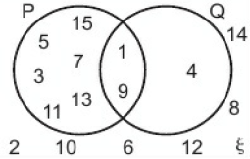
10.6 – Venn Diagrams and Set Notation
Page 321
The Venn diagram shows two sets, P and Q, and the set of all numbers being considered, £. Write all the elements of each set inside curly brackets {}.
P b. Q c. §
Which set is {square numbers < 16}?
Write descriptions of the other two sets.

Slide 73
10.6 – Venn Diagrams and Set Notation
Page 322
Key Point 16
A ∩ B means 'A intersection B'. This is all the elements that are in A and in B.
A U B means A union B’. This is all the elements that are in A or B or both.
A‘ means the elements not in A.
§ means the universal set - all elements being considered.
For the Venn diagram in Q3, write these sets,
P U Q b. P ∩ Q
P' d. Q'
P’ ∩ Q f. Q' ∩ P

Slide 74
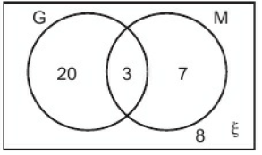
10.6 – Venn Diagrams and Set Notation
Page 322
Key Point 17
You can calculate probabilities from Venn Diagrams
Example 6
The Venn diagram shows the number of students studying German (G) and Mandarin (M).
A student is picked at random. Work out
P(G ∩ M) b. P(G') c. P(G U M)
20 + 3 + 7 + 8 = 38 P(G ∩ M) = $\frac{3}{38}$
P(G’) = $\frac{7+8}{38}$ = $\frac{15}{38}$
P(G U M) = $\frac{20+3+7}{38}$ = $\frac{30}{38}$
Work out the total number of students.
$\frac{Number of students in G\text{∩}M}{total number of students}$
$\frac{Number of students in G′}{total number of students}$

Slide 75
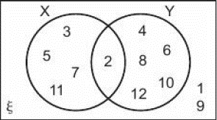
10.6 – Venn Diagrams and Set Notation
Page 323
The Venn diagram shows two events when a 12-sided dice is rolled: prime numbers and multiples of 2. X = {number is prime} Y = {number is a multiple of 2} Work out
P(X) b. P(Y) c. P(X ∩ Y)
P(X U Y) e. P(X') f. P(Y')
P(X ∩ Y') h. P(X' U Y)

Slide 76
10.6 – Venn Diagrams and Set Notation
Page 323
Reasoning Charlie asks the 30 students in his class if they passed their English (E) and maths (M) tests. 21 students passed both their English and maths tests. 2 students didn't pass either test. 25 students passed their maths test,
Draw a Venn diagram to show Charlie's data,
Work out
P(E) ii. P(E ∩ M)
P(E U M)
P(E' ∩ M)

Slide 77
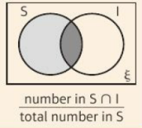
10.6 – Venn Diagrams and Set Notation
Page 323
Lucy carried out a survey of 150 students to find out how many students play an instrument (I) and how many play for a school sports team (S). 63 students play on a school sports team. 27 students play an instrument and play on a school sports team. 72 students do not either play an instrument or play on a school sports team.
Draw a Venn diagram to show Lucy's data,
Work out the probability that a student plays an instrument,
Work out the probability that a student plays an instrument given that they play on a school sports team.
Q6c hint –

Slide 78
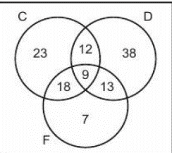
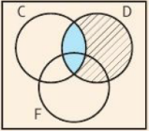
10.6 – Venn Diagrams and Set Notation
Page 323
Key Point 18
A ∩ B ∩ C means the intersection of A, B and C.
A U B U C means the union of A, B and C.
P(A ∩ B | B) means the probability of A and B given B.
Caitlin did a survey of pet owners owning cats (C), dogs (D) and fish (F). The Venn diagram shows her results,
How many people took part in the survey?
One of the pet owners is chosen at random,
Work out
P(C)
P(C ∩ D | D)
P(D ∩ F | F).
Q3 hint - P(C ∩ D | D) means the probability of a cat and dog owner given that pet owner owns a dog.

Slide 79
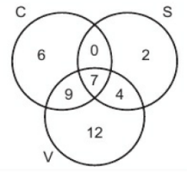
10.6 – Venn Diagrams and Set Notation
Page 324
The Venn diagram shows people's choice of chocolate (C), strawberry (S) and vanilla (V) ice cream flavours for the 'three scoops' dessert,
How many people had all three flavours?
How many people chose ice cream for dessert?
Work out
P(C ∩ S ∩ V)
P(S ∩ V)
P(S ∩ V | S).

Slide 80
10.6 – Venn Diagrams and Set Notation
Page 324
10 – Exam-Style Questions
There are 80 students at a language school.
All 80 students speak at least one language from French, Italian and Spanish. 7 of the students speak French, Italian and Spanish.
15 of the students speak French and Italian.
26 of the students speak French and Spanish.
17 of the students speak Italian and Spanish.
41 of the students speak French.
52 of the students speak Spanish.
Draw a Venn diagram to show this information. (3 marks)
One of the students is chosen at random,
Work out the probability that this student speaks French but not Italian. (2 marks)
Given that the student speaks Spanish,
work out the probability that this student also speaks French. (2)
Q10c strategy hint - Once you have put the number 7 in the overlap of all three circles, you can work out another number to fill in on your diagram for each sentence in the question.

Slide 81
10 – Problem-solving: Drug Testing
Page 325
Objectives | Be able to construct and use a tree diagram to find probabilities. Be able to calculate a cost and compare two different scenarios.

Slide 82
10 – Problem-solving: Drug Testing
Page 325
Drug testing is widely used in sport, to help ensure fair play. These tests aim to identify any athletes guilty of taking performance-enhancing drugs. However, they are never 100% accurate and different methods have different success rates.
The table below shows the two different types of drug tests offered by one company.
It is suspected that 5% of athletes at an international athletics event are taking performance enhancing drugs.
Complete the tree diagram below for test A by filling in the probabilities. What percentage of people taking the test will test positive, even though they haven't taken any drugs?
Q1 communication hint – A 'positive' test result means the test shows that drugs have been taken. A 'negative' test result means the test shows that drugs have not been taken.

Slide 83
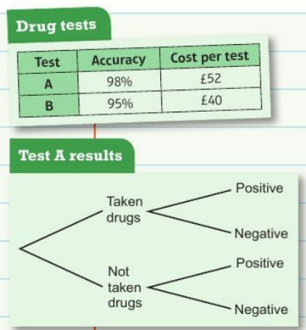
10 – Problem-solving: Drug Testing
Page 325
Draw a tree diagram for test B. Using your tree diagram, explain why half the people who tested positive are actually innocent.
Q2 hint - Compare the probability of a false positive (a result that incorrectly shows the athlete has taken drugs) and a genuine positive result.

Slide 84
10 – Problem-solving: Drug Testing
Page 325
The organisers of the event must choose to use test A or test B. They need to consider the overall cost and the reliability of the test results. (Reputations would be damaged if they accused innocent competitors of using drugs, or if they let guilty competitors get away with drug taking.) At the event a random sample of 600 participants are tested. To improve accuracy, all positive results are tested again at the same cost. If the retest shows a positive result the competitor will be found guilty of using performance-enhancing drugs.
By comparing the costs and the overall reliability of the tests, decide which of the two tests you would recommend to the organisers. Make sure you include calculations to create a convincing argument.
Q3 hint - Start by working out how many tests will need to be taken. This needs to include any retests.

Slide 85
10 – Check Up
Page 326
10. Check up | Log how you did on your Student Progression Chart
Calculating probability
The probability that it will rain today is 0.3. The probability that it will rain tomorrow is 0.25. The two probabilities are independent,
Work out the probability that it will not rain tomorrow,
Work out the probability that it will rain today and tomorrow.
A and B are mutually exclusive. P(B) = 0.A5, P(A or B) = 0.6. Work out P(A).

Slide 86
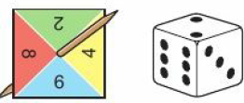
10 – Check Up
Page 326
A bag contains toy animals. Emma takes an animal from the bag at random.
The probability of choosing a sheep is $\frac{1}{5}$. What is the probability of choosing an animal that is not a sheep?
The probability of choosing a pig is $\frac{1}{2}$. What is the probability of choosing a sheep or a pig?
Ewan spins the spinner and rolls the 6-sided dice. He finds the total of the outcomes,
Draw a sample space diagram to show all the possible outcomes.
Work out the probability of scoring a total of
8 ii. a multiple of 3
more than 9.

Slide 87
10 – Check Up
Page 326
Jane records the hair colour of students in her class and whether they wear glasses. The two-way table shows her results. A student is chosen at random. Given that a student has dark hair, what is the probability that they wear glasses?
 | Hair Colour
 | Fair | Dark | Ginger | Total
Wears Glasses | 0 | 2 | 1 | 3
Does not wear Glasses | 13 | 15 | 1 | 29
Total | 13 | 17 | 2 | 32

Slide 88
10 – Check Up
Page 326
Experimental probability
The table shows the probability of each number on a six-sided spinner. The spinner is equally as likely to land on 3 as it is to land on 5.
Copy and complete the table.
The spinner is spun 300 times.
How many times would you expect the spinner to land on A?
Is the spinner fair? Explain your answer.
Number | 1 | 2 | 3 | 4 | 5 | 6
Probability | 0.2 | 0.3 |  | 0.15 |  | 0.15

Slide 89
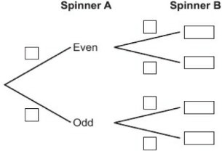
10 – Check Up
Page 327
Tree diagrams and Venn diagrams
Grace spins two spinners, A and B. The probability of getting an even number on spinner A is 0.4. The probability of getting an even number on spinner B is 0.65.
Copy and complete the tree diagram to show all the possible probabilities.
Work out the probability of getting an even number on
i neither spinner
ii only one spinner.

Slide 90
10 – Check Up
Page 327
Reasoning Lewis surveyed 140 students in his year group to find out if they sent text messages or emails last week. 79 students sent text messages and emails. 126 students sent text messages,
Draw a Venn diagram to show Lewis's data.
A student is chosen at random.
Work out the probability that the student sent an email last week,
Given that the student sent a text message, work out the probability that they sent an email.

Slide 91
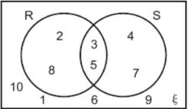
10 – Check Up
Page 327
The Venn diagram shows two sets, R and S. Copy and complete
R = { }
R’ = { }
R ∩ S = { }
E = { }
Is 4 ϵ R U S true?
How sure are you of your answers? Were you mostly Just guessing ☹ Feeling doubtful 😐 Confident ☺
What next? Use your results to decide whether to strengthen or extend your learning.
Reflect

Slide 92
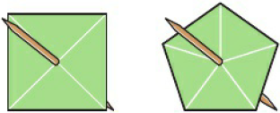
10 – Check Up
Page 327
* Challenge
a. Use the numbers 1 to 6 to fill in the sectors of these two spinners so that when the results are added together the probability of getting a total of 7 is Draw a sample space diagram to help you.
Both of your spinners are spun once and the results are added together. This is then repeated. Draw a tree diagram to show the probability of getting a total of 7 or not a total of 7 on each spin.
Use your tree diagram to work out the probability of spinning two 7s.

Slide 93
10 – Stregthen
Page 328
10. Strengthen
Calculating probability
Below are some lettered tiles. One of these tiles is selected at random. Work out
P(l) b. 1 - P(l) c. P(not I).
What do you notice about your answers to parts b and c?
Work out
P(T) ii. P(not T).
Using the tiles in Q1, work out
P(A) b. P(S) c. P(A or S).
What do you notice about your answers to parts a, b and c?
Work out P(l or T).
Q1c hint - List all the letters not I
S
T
A
T
I
S
T
I
C
S
Q1e hint - Use your answer to part d to help you.
Q2c hint - How many letters are A or S?
Q2e hint - Use your answer to part d to help you.

Slide 94
10 – Strengthen
Page 328
The probability of getting a letter 'S' on a tile in a word game is 0.05. The probability of getting tiles 'S' or 'E' is 0.2. Work out the probability of getting the tile 'E'.
Leah is playing in two netball matches tomorrow. Her team can win, draw or lose their matches,
Copy and complete the sample space diagram to show all the possible outcomes for both matches,
How many possible outcomes are there? What is the probability that Leah's team draw both of their matches?
Write down the outcomes that will give Leah's team at least one win.
What is the probability of the team winning at least once?
Q3 hint - P(S or E) = P(S) + P(E).
 |  | 1st match
 |  | Win | Draw | Lose
2nd Match | Win | W, W | W, W
 | Draw
 | Lose | D, L
Q4c hint – ‘Winning at least once’ means one or more then one win.

Slide 95
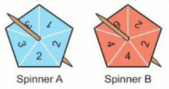
10 – Strengthen
Page 328
Brad spins these two fair spinners.
Draw a sample space diagram to show all the possible outcomes. How many are there?
Work out the probability of
a 3 ii. one number being double the other.
Which is more likely: two even numbers or two odd numbers? Brad spins the two spinners and adds the two numbers together.
Draw a new sample space diagram to show the scores,
Which score is most likely?
What is the probability of scoring at least 6?
Q5a hint – ‘Put spinner A on the horizontal axis and spinner B on the vertical axis.
Q5c hint – Use the same axes as in part a. For the result 1,2, the score is 1 + 2 = 3.

Slide 96
10 – Strengthen
Page 329
Mohammed surveyed the students in his year group to see who had school dinners and who had a packed lunch. The two-way table shows his results.
How many female students are there?
A student is chosen at random. Given that the student is female, work out the probability that the student has a packed lunch.
 | School Dinner | Packed Lunch | Total
Male | 27 | 46 | 73
Female | 36 | 41 | 77
Total | 63 | 87 | 150
Q6b hint – What fraction of females have packed lunches?

Slide 97
10 – Strengthen
Page 329
A pack of cards is numbered from 1 to 20. For each of the questions, state if you need to add or multiply the probabilities,
Two cards are chosen at random. Work out the probability of choosing an even number and an odd number,
A card is chosen at random. Workout the probability of choosing a multiple of 5 or a multiple of 9.
Two cards are chosen at random. Work out the probability of choosing two prime numbers.
Two cards are chosen at random. Work out the probability of choosing two multiples of 3.
Q7 hint – P(A or B) = P(A) + P(B) P(A and B) = P(A) * P(B)

Slide 98
10 – Strengthen
Page 329
Experimental probability
A machine used to pack crisps had 200 bags tested for weight. 10 of the bags were underweight,
Estimate the probability that the next bag of crisps from the machine is underweight,
The machine packs 500 bags. How many would you expect to be underweight?
The machine packs 720 bags. How many would you expect to be underweight?
Q1a hint – It is an 'estimate' because it is not theoretical probability. 'Estimate' does not mean 'take a guess', it means use the information given.
Q1b hint – Use your answer to part a to help you.

Slide 99
10 – Strengthen
Page 329
Dylan makes a six-sided spinner. He spins it 180 times and gets 15 threes.
How many threes would you expect in 180 spins of a fair spinner?
Do you think Dylan's spinner is fair? Explain.
Megan spun a spinner 80 times. The table shows her results.
Estimate the probabilities for each of the five outcomes.
Megan spun the spinner another 150 times. How many times would you expect it to land on 1?
Number | Frequency
1 | 16
2 | 12
3 | 14
4 | 17
5 | 21
Q2 hint – Is the expected number close to the actual number?

Slide 100
10 – Strengthen
Page 330
Tree diagrams and Venn diagrams
A pack of cards is numbered from 1 to 20. For each question, state if it is with or without replacement.
Two cards are chosen at random. Work out the probability of choosing an even number and art odd number.
A card is chosen at random and then shuffled in the pack before another card is chosen. Workout the probability of choosing a multiple of 5 and a multiple of 9.
Two cards are chosen at random. Work out the probability of choosing two prime numbers.

Slide 101
10 – Strengthen
Page 330
A pack of cards is numbered from 1 to 20. For which questions would you draw a tree diagram?
Two cards are chosen at random. Work out the probability of choosing an even number and art odd number.
Two cards are chosen at random. Work out the probability of choosing two prime numbers,
A card is chosen at random. Work out the probability of not getting a prime number.

Slide 102
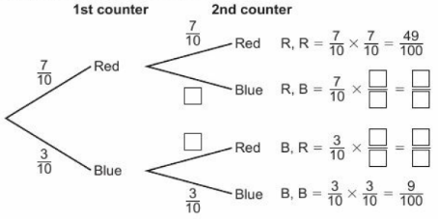
10 – Strengthen
Page 330
The tree diagram shows the probabilities of picking a counter from a bag, replacing the counter and then choosing another counter.
Copy and complete the diagram and calculations to show all the probabilities,
Work out the probability of getting one red counter.
Q3 hint - P(one Red) = P(R, B or B, R) = P(R, B) + P(B, R)

Slide 103
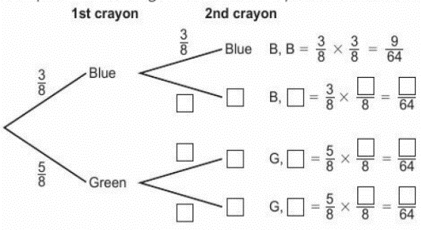
10 – Strengthen
Page 330
Jane has a box of crayons with 3 blue crayons and 5 green crayons. She chooses a crayon at random, uses it, replaces it and then chooses another crayon at random,
Copy and complete the tree diagram to show all the probabilities and calculations.
Work out the probability of Jane choosing
a blue and green crayon
2 green crayons
at least one green crayon.
Q4b iii hint - Which outcomes have one or more green?

Slide 104
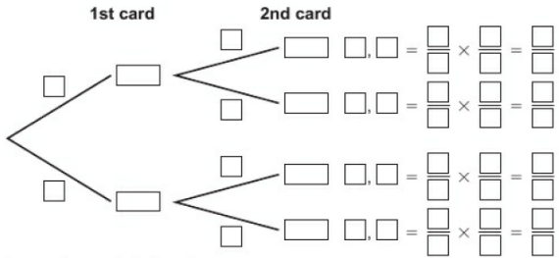
10 – Strengthen
Page 331
Paige shuffles an ordinary pack of cards. She turns a card over, returns it to the pack for another shuffle and then turns over another card.
Draw a tree diagram to show all the probabilities and calculations of choosing a heart. Work out the probability that
both cards are hearts
one card is a heart.
Q5a hint – ¼ of the cards are heart:

Slide 105
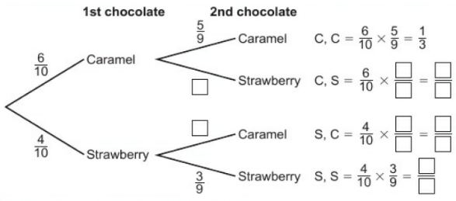
10 – Strengthen
Page 331
Louis has a box of chocolates. 6 of the chocolates are caramel centres and 4 of them are strawberry centres. Louis picks a chocolate at random and eats it. He then picks another chocolate at random,
What is P(caramel) for the first chocolate?
Louis picks and eats a caramel. What is P(caramel) for his second chocolate?
Copy and complete the tree diagram to show all the probabilities and calculations.
Work out the probability that Louis picks
two different chocolates
at least one strawberry.
Q6b hint – □ 9

Slide 106
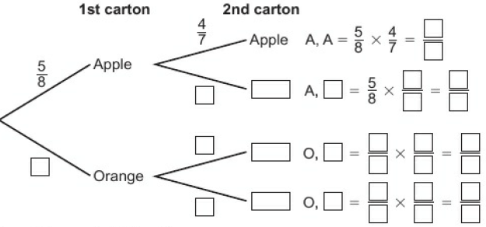
10 – Strengthen
Page 331
Nathan has 8 cartons of juice in the fridge. 5 of the cartons are apple juice and 3 of the cartons are orange juice. Louis chooses two cartons at random,
Copy and complete the tree diagram to show all the probabilities and calculations.
Work out the probability of
both cartons being orange juice c. one of each flavour.

Slide 107
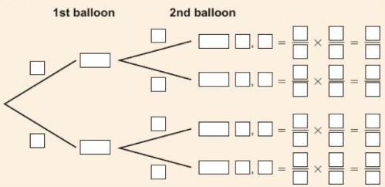
10 – Strengthen
Page 332
Shannon has a bag of balloons to blow up for a party. In the bag are 7 red balloons and 5 yellow balloons. Shannon takes a balloon at random, blows it up and then takes another balloon at random.
Draw a tree diagram to show all the probabilities and calculations.
Work out the probability of
the two balloons being the same colour
the first balloon being red and the second yellow.
Q8a hint –

Slide 108
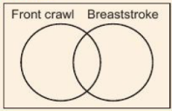
10 – Strengthen
Page 332
Reasoning Rachel surveys people swimming at her local swimming pool. 15 people swim front crawl. 12 people swim breaststroke. 7 people swim both front crawl and breaststroke.
Draw a Venn diagram.
Write the number for front crawl and breaststroke in the section where the circles overlap.
How many people need to go in the rest of the front crawl circle? Write your answer on your Venn diagram.
How many people need to go in the rest of the breaststroke circle? Write your answer on your Venn diagram.
Work out the total number of people in the Venn diagram.
What is the probability that a person chosen at random
swims front crawl and breaststroke
swims front crawl only?
Given that a person picked at random swims front crawl, what is the probability they also swim breaststroke?
Q9a hint –
Q9a ii hint – The total in the whole front crawl circle needs to be 15.
Q9d hint – What fraction of 'front crawl' people also swim breaststroke?

Slide 109
10 – Strengthen
Page 332
Georgia carries out a survey of 50 people. 5 people are married and aged under 25. 27 people are married.
Draw a Venn diagram to show Georgia's survey results,
Work out the probability that a person chosen at random is married,
Work out the probability that a person chosen at random is married given that they are under 25.
Q10 hint – Shade all those married on your Venn diagram. How many are under 25?
P(married given that they are under 25) = $\frac{\text{number} \text{of} \text{people} \text{married} \text{and} \text{under}\text{ 25 }}{\text{total} \text{number} \text{of} \text{people} \text{under}\text{ 25 }}$

Slide 110
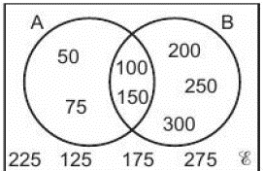
10 – Strengthen
Page 333
Look at the Venn diagram,
List the numbers in
A ii. B iii. A U B
A ∩ B v. ؏
Copy and complete
200 ϵ □ ii. 175 ϵ □
700 ϵ □ ∩ □
Q11a iii hint – A U B means A or B or both
Q11a iv hint – A ∩ B means A and B
Q11a v hint – ؏ includes A and B
Q11b hint – 50 ϵ A means 50 in an element of A and B

Slide 111
10 – Strengthen
Page 333
10. Extend
Design a set of counters so that P(red) = P(green) = $\frac{1}{5}$ and P(blue) = ½ and there are half as many yellow counters as red ones.
Problem-solving Two players are playing a card game with these sets of cards. Both players shuffle their cars and turn over the top card. Make up a rule for each player to win so that the game is fair. Use probability to show that the game is fair.

Slide 112
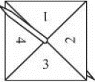
10 – Strengthen
Page 333
3 – Exam-Style Questions
Here is a four-sided spinner. The spinner is biased.
The table shows the probabilities that the spinner will land on a 1 or on a 3.
The probability that the spinner will land on 2 is the same as the probability that the spinner will land on 4.
Work out the probability that the spinner will land on 4. (3 marks)
Shunya is going to spin the spinner 200 times,
Work out an estimate for the number of times the spinner will land on 3. (2 marks)
March 2013, Q4, 1MA0/2H
Number | 1 | 2 | 3 | 4
Probability | 0.2 |  | 0.1
Exam hint - Write down calculations, even if you do them in your head.

Slide 113
10 – Strengthen
Page 334
Finance The number of FTSE 100 company share prices that went down from the previous day were recorded for 50 days,
Estimate the probability that on the next day
41-60 share prices will go down
more than 60 share prices will go down. Give your answers as percentages.
Number of share prices that went down | Frequency
1-20 | 3
21-49 | 19
41-60 | 12
61-80 | 9
81-100 | 1
The London stock exchange trades for 253 days in a year. On how many days would you expect fewer than 41 share prices to fall?
Estimate the probability that fewer than 41 share prices will fall on each of two consecutive days. Give your answer as a percentage.
Q4 communication hint - The largest 100 companies on the London stock market are called the FTSE 100. Each day, their share prices can go up, down or stay the same.

Slide 114
10 – Strengthen
Page 334
5 – Exam-Style Questions
There are 17 girls and 14 boys in Mr. Taylor’s class.
Mr. Taylor is going to choose at random 3 children from his class.
Work out the probability that he will choose exactly 2 girls and 1 boy.
(4 marks)
March 2012, Q4, 23S1/6A
Q5 strategy hint - Start by writing down the probability of choosing a girl.

Slide 115
10 – Strengthen
Page 334
Problem-solving Ali has a bag of red, yellow and blue counters in the ratio 2:1:3. Brad has a bag of red, yellow and blue counters in the ratio 4:3:1. Ali and Brad have 12 red counters each. Ali takes a counter out of his bag and puts it into Brad's bag. Brad then takes a counter out of his bag at random. Work out the probability that they both choose a counter of the same colour.

Slide 116
10 – Strengthen
Page 334
Reasoning Tom has a bag with these shapes in. Tom drops the bag and two shapes fall out.
Work out the probability that the two shapes are not regular polygons,
Work out the probability that the two shapes have an interior angle sum of 540°.
Work out the probability that the one of the shapes has an interior angle sum of 360° and the other has an interior angle sum of 540°.

Slide 117
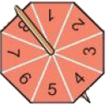
10 – Strengthen
Page 334
Reasoning The fair 12-sided dice is rolled and the fair eight-sided spinner is spun. The numbers rolled by the dice are used for the x-coordinates, and the numbers spun by the spinner are used for the y-coordinates. Find the probability that the point generated by the two numbers lies on each of the following lines,
x = 2 b. x + y =9
y = x + 3 d. y = ½x - 1

Slide 118
10 – Strengthen
Page 334
Problem-solving There is an 85% chance that a battery wiII last longer than the advertised life of the battery. The batteries are sold in packets of two. A shop has 200 packets of the batteries in stock. Find an estimate for the number of packets that will have exactly one battery that lasts longer than the advertised life of the battery.

Slide 119
10 – Strengthen
Page 335
Problem-solving There is an 85% chance that a battery will last longer than the advertised life of the battery. The batteries are sold in packets of two. A shop has 200 packets of the batteries in stock. Find an estimate for the number of packets that will have exactly one battery that lasts longer than the advertised life of the battery.

Slide 120
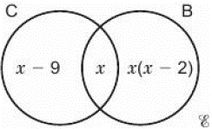
10 – Strengthen
Page 335
Reasoning Mike is a stamp collector. The Venn diagram shows information about his stamp collection.  = {Mike's full collection of 720 stamps} C = {stamps from the 20th century} B = {British stamps} A stamp is chosen at random. It is from the 20th century. Work out the probability that it is British.

Slide 121
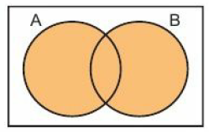
10 – Strengthen
Page 335
Use set notation to describe the shaded area in each Venn diagram.

Slide 122
10 – Knowledge Check
Page 335
10 – Knowledge Check
A sample space diagram shows all the possible outcomes of two events. Two events are mutually exclusive if they cannot happen at the same time. When two events are mutually exclusive you can add their probabilities. The probabilities of an exhaustive set of mutually excusive events sum to 1. For mutually exclusive events, P(not A) = 1 - P(A) If there are m outcomes for one event and n outcomes for another event, the product rule states that the total number of outcomes for the two events is m x n. Expected number of outcomes = number of trials x probability Relative frequency = $\frac{frequency}{\text{total} \text{number} \text{of} \text{trials}}$
Mastery Lesson 10.1
Mastery Lesson 10.2
Mastery Lesson 10.2
Mastery Lesson 10.3
Mastery Lesson 10.3

Slide 123
10 – Knowledge Check
Page 335
10 – Knowledge Check
As the number of experiments increases, the experimental probability gets closer and closer to the theoretical probability. ............................... A tree diagram shows two or more events and their probabilities. Two events are independent if one happening does not affect the probability of the other. To find the probability of two independent events multiply their probabilities, P(A and B) = P(A) x P(B) The probability for a repeated independent event is the probability multiplied by itself, P(A and A) = P(A) x P(A), P(A and A and A) = P(A) x P(A) x p(A), etc. A conditional probability is when one outcome affects another outcome.
Mastery Lesson 10.3
Mastery Lesson 10.4
Mastery Lesson 10.4
Mastery Lesson 10.4
Mastery Lesson 10.5

Slide 124
10 – Knowledge Check
Page 336
10 – Knowledge Check
P(A ∩ B) means the probability of the intersection of A and B. P(A ∪ B) means the probability of the union of A and B. P(A ∪ B) = P(A) + P(B) - P(A ∩ B) P(A ∩ B | B) means the probability of the intersection of A and B given B. Write down a word that describes how you feel before a maths test, b. during a maths test after a maths test. Beside each word, draw a face, ☺ or ☹ to show if it is a good or a bad feeling. Discuss with a classmate what you could do to change ☹ feelings to ☺ feelings.
Mastery Lesson 10.6
Mastery Lesson 10.6
Reflect
Hint - Here are some possible words: OK, worried, excited, happy, focused, panicked, calm.

Slide 125
10 – Unit test
Page 336
10. Unit Test | Log how you did on your Student Progression Chart.
14 – Exam-Style Questions
Riki has a packet of flower seeds.
The table shows each of the probabilities that a seed taken at random will grow into a flower that is pink or red or blue or yellow.
Work out the probability that a seed taken at random will grow into a white flower. (2 marks)
There are 300 seeds in the packet.
All the seeds grow into flowers.
Work out an estimate for the number of red flowers. (2 marks)
March 2012, Q9, I380/4H
Colour | Pink | Red | Blue | Yellow | White
Probability | 0.15 | 0.25 | 0.20 | 0.16 | 38
Exam hint
As each part is worth 2 marks, you will need to write down the calculations you do before writing the answer.

Slide 126
10 – Strengthen
Page 336
A company launches a new smartphone. The phone is made in five different colours with three different storage capacities.
How many combinations are there?
(2 marks)
One of the phones is pink with 16Gb of memory. What is the probability that this combination is bought? (2 marks)
In a football tournament at group stage there are five football teams in a group, Brazil, England, Scotland, Argentina and France. Each team plays every other team in their group. There are ten matches altogether. Two teams are picked at random to play the first match. Work out the probability that the first game will be played by a European team and a South American team. (3 marks)

Slide 127
10 – Strengthen
Page 337
Problem-solving A and B are two mutually exclusive events. P(A) = 0.35 and P(A or B) = 0.8. Work out P(not B). (2 marks)
State whether each pair of events is independent or dependent,
Randomly taking two sweets from a bag. (1 mark)
Spinning a five-sided spinner three times, (1 mark)
Randomly taking a marble from a bag and then taking another one. (1 mark)
Randomly taking a marble from a bag, replacing it, and then taking another one. (1 marks)

Slide 128
10 – Strengthen
Page 337
6 – Exam-Style Questions
Tom plants 3 seeds. The probability that a seed will germinate is 5.
Calculate the probability that all 3 seeds will germinate. (2 marks)
Calculate the probability that at least one of the seeds will germinate. (3 marks)
March 2010, Q5, 2381/6B
7– Exam-Style Questions
There are 11 small jars on a table. Three of the jars contain honey.
Eight of the jars contain jam.
Rosie takes, at random , two of the jars for her breakfast. Work out the probability that she takes at least one jar of honey. (4 marks)
Nov 2010, Q5, 238I/6B

Slide 129
10 – Strengthen
Page 337
The Venn diagram shows the numbers of people who chose baguettes (B) and soup (S). (4 marks) Use the Venn diagram to find
P(B) b. P(S')
P(B ∩ S) d. P(B ∪ S)
Problem-solving A class of 27 students is split between boys and girls in the ratio of 5:4. Work out the probability that two students chosen at random are both boys. (4 marks)

Slide 130
10 – Strengthen
Page 337
The Venn diagram shows customers’ choice of sausages (S), bacon (B) and egg (E) fillings for an all-day-breakfast sandwich in a cafe.
How many people chose all three fillings? (1 mark)
A customer is chosen at random. Work out
i. P(B ∩ E) (1 mark)
P(S ∩ B ∩ E) (2 marks)
P(S ∩ E | S) (2 marks)

Slide 131
10 – Strengthen
Page 338
Sample student answer
What is missing from the tree diagram?
What is missing from the calculations on the right of the tree diagram?
What else is missing from their response?
Exam-Style Questions
Sally has a bag of 9 sweets. In the bag, there are
3 orange flavoured sweets
4 strawberry flavoured sweets and 2 lemon flavoured sweets
Sally takes, at random, two of the sweets. She eats the sweets.
Work out the probability that the two sweets Sally eats are not of the same flavour. (4 marks)
Mock paper, Q23, IMAO/IH

Slide 132
10 – Strengthen
Page 338
Student answer

